Slide 1
Understanding Parasitic Capacitances

Slide 2
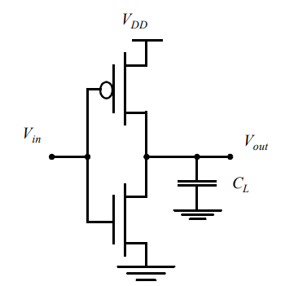
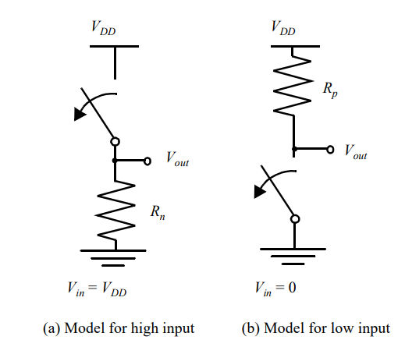
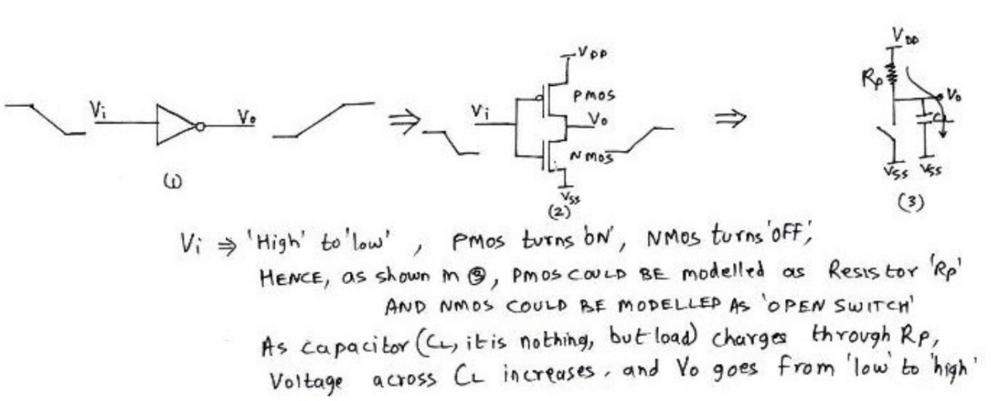
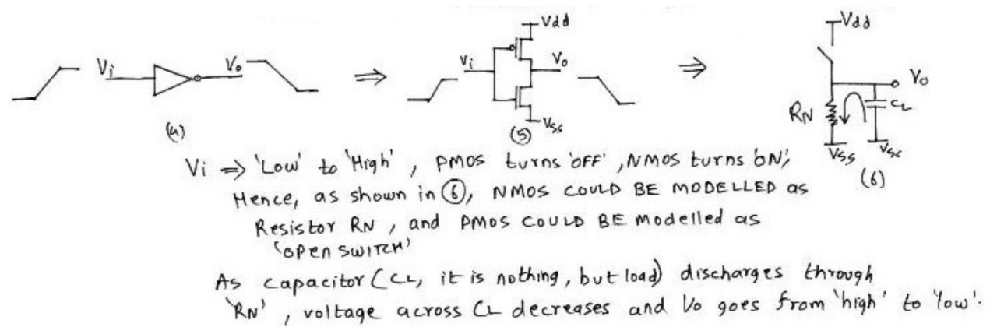
This can be considered as the RSW(switching resistance)

Slide 3
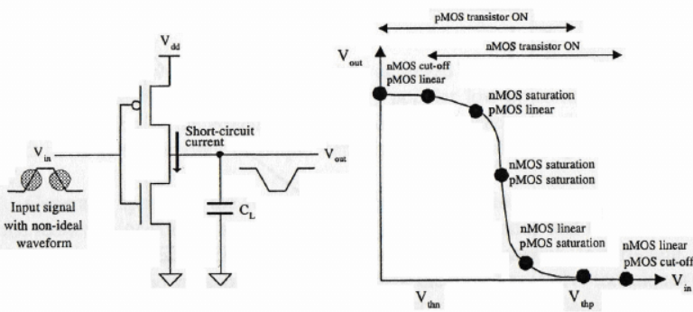
Propagation delay of the CMOS inverter is determined by the time it takes to charge and discharge the load capacitor CL through the PMOS and NMOS transistors, respectively.
Getting CL as small as possible is crucial to the realization of high-performance CMOS circuits
Propagation Delay (τ_{p}) to charge/discharge the capacitor α R_{P} C_{L} or R_{N}C_{L}
So C_{L} should be decreased and R_{P} & R_{N} should be decreased (may be by W/L or it also depend on V_{g})

Slide 4
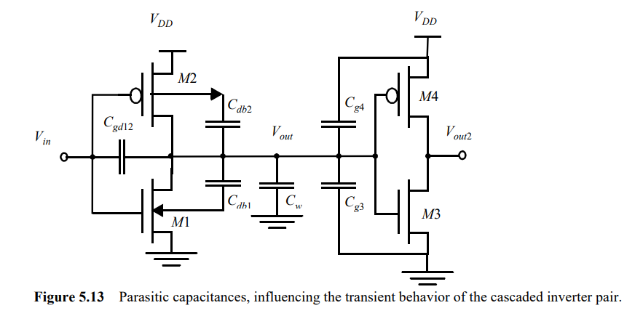

Slide 5
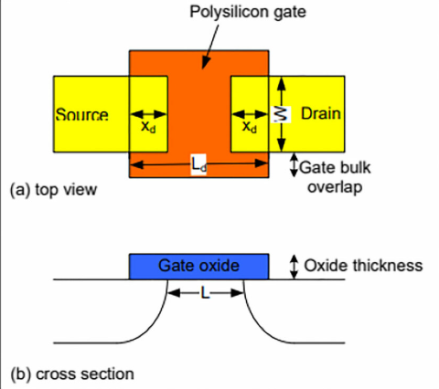
To make the analysis tractable, we assume that all capacitances are lumped together into one single capacitor CL , located between V_{dd} and GND. Be aware that this is a considerable simplification of the actual situation, even in the case of a simple inverter.
It is initially assumed that the input Vin is driven by an ideal voltage source with zero rise and fall times. Accounting only for capacitances connected to the output node, CL breaks down into the following components.
Understanding the overlap capacitances
overlapping capacitances refer to parasitic capacitances formed due to the overlap of the gate electrode with the source and drain regions.
mainly caused by fabrication constraints. The primary reason for their existence is the misalignment between the gate and the source/drain regions during the manufacturing process.
X_{d} = lateral diffusion
L = 2X_{d}
C_{GSO} = C_{GDO} = C_{ox} X_{d} W = C_{o} W

Slide 6
Gate to Channel Capacitances (C_{gc})
Divided into three types C_{gcs} , C_{gcb} , C_{gcd} (Gate to channel where channels are source, body(substrate) and drain respectively)
It depends upon region of operation and terminal voltage
During cutoff region ,(the drain and source are non conducting , hence only gate to body capacitance remain) ; so C_{gc} = C_{gcb}
When Linear region is reached inversion layer is formed so it shields the body from the oxide layer between gate and body hence C_{gcb} becomes 0 and the capacitances are evenly distributed between source and drain hence C_{gcs} = C_{gcd} = C_{ox} WL/2
When saturation reigon is reached ; pinchoff occurs near the drain for NMOS hence now C_{gcb} & C_{gcd} both becomes 0. and experimentally C_{gcs} = 2/3 (C_{ox} WL)

Slide 7
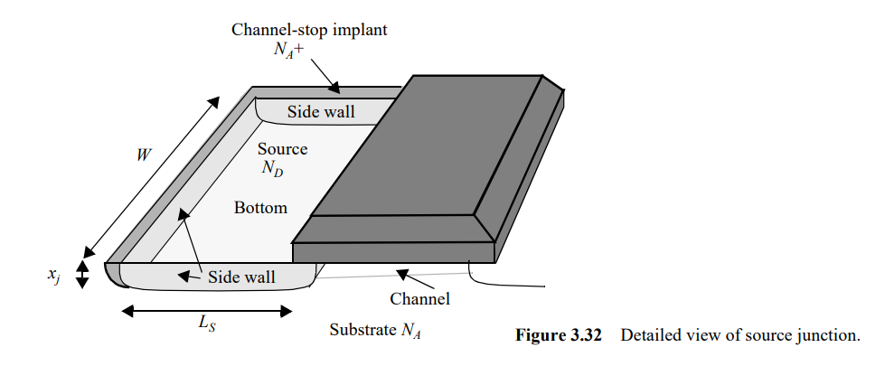

Junction Capacitances / Diffusion Capacitance(C_{db})
Caused due to reverse biasing between source and body and drain and body
The depletion-region capacitance is nonlinear and decreases when the reverse bias is raised
To understand this , look at the source drain capacitances and the reigon around it
The bottom-plate junction, which is formed by the source region (with doping N_{D} ) and the substrate with doping N_{A} . The total depletion region capacitance for this component equals C_{bottom} = C_{j}WLS , with C_{j} the junction capacitance per unit area
The side-wall junction, formed by the source region with doping N_{D} and the p + channel-stop implant with doping level N_{A} + . The doping level of the stopper is usually larger than that of the substrate, resulting in a larger capacitance per unit area

Slide 8
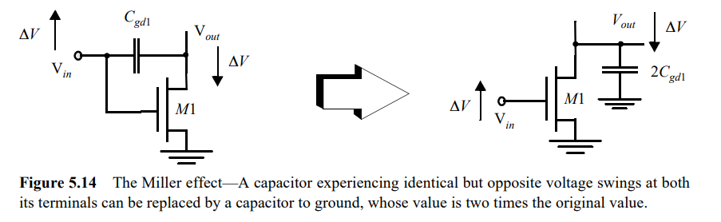
Gate Drain Capacitance
This capacitance introduces a feedback path between the output and input due to the Miller effect. During switching, the effective capacitance seen at the gate is amplified by the gain of the inverter, slowing down the transition.
The Miller effect refers to the phenomenon where a small capacitance, such as the gate-to-drain capacitance (Cgd​) in a MOSFET or other amplifying device, appears larger when viewed from the input side due to the voltage gain of the circuit. This effect is particularly significant in high-speed digital and analog circuits.
It significantly increases the propagation delay when the output voltage changes.
During a low-high or high-low transition, the terminals of the gate drain capacitor are moving in opposite directions .The voltage change over the floating capacitor is hence twice the actual output voltage swing. To present an identical load to the output node, the capacitance-to-ground must have a value that is twice as large as the floating capacitance

Slide 9
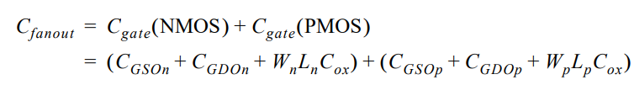
Wiring Capacitance(C_{W})
The capacitance due to the wiring depends upon the length and width of the connecting wires, and is a function of the distance of the fanout from the driving gate and the number of fanout gates
Gate Capacitance
It assumes that all components of the gate capacitance are connected between V_{out} and GND (or V_{DD}), and ignores the Miller effect on the gate-drain capacitances. This has a relatively minor effect on the accuracy, since we can safely assume that the connecting gate does not switch before the 50% point is reached, and Vout2, therefore, remains constant in the interval of interest.
A second approximation is that the channel capacitance of the connecting gate is constant over the interval of interest.
During the first half of the transient, it may be assumed that one of the load devices is always in linear mode, while the other transistor evolves from the off-mode to saturation. Ignoring the capacitance variation results in a pessimistic estimation with an error of approximately 10%, which is acceptable for a first order analysis

Slide 10
